Slide 1
CHGM-141
General and Analytical Chemistry I
Lecture 16
(Ch. 6) with Dr. Bailey
Chemical Composition
Empirical and Molecular Formulas
Determining the Formula of a Hydrocarbon by Combustion

Slide 2
Chemical Composition
Moles! Moles! Moles!

Slide 3
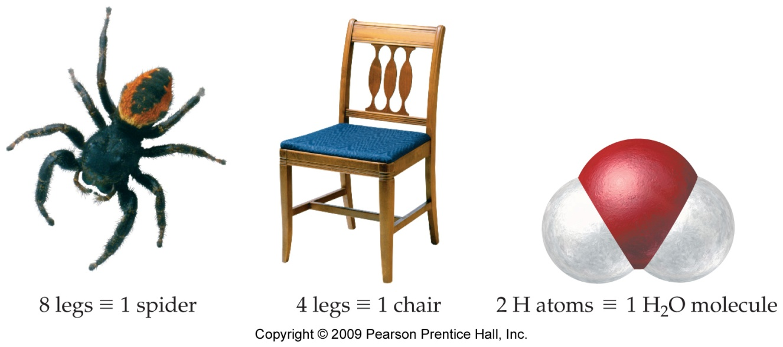
Chemical Formulas as Conversion Factors
1 spider ≡ 8 legs.
1 chair ≡ 4 legs.
1 H₂O molecule ≡ 2 H atoms ≡ 1 O atom.

Slide 4

Counting Parts
If we know how many parts are in the whole unit, by counting the number of whole units, we can effectively count the parts.
For example, when all the chairs in the room have 4 legs, if there are 30 chairs in the room, there will be 120 legs (4 x 30).
Since every H₂O molecule has 2 H atoms, in 100 H₂O molecules, there are 200 H atoms.
In 1 mole of H₂O molecules, there are 2 moles of H atoms.

Slide 5
Mole Relationships in
Chemical Formulas
Since we count atoms and molecules in mole units, we can find the number of moles of a constituent element if we know the number of moles of the compound.
Moles of compound | Moles of constituents
1 mol NaCl | 1 mol Na, 1 mol Cl
1 mol H₂O | 2 mol H, 1 mol O
1 mol CaCO₃ | 1 mol Ca, 1 mol C, 3 mol O
1 mol C₆H₁₂O₆ | 6 mol C, 12 mol H, 6 mol O

Slide 6
Building Molecules
Consider carbon dioxide – CO₂
It’s just like a little house made out of different size bricks
C
O
O

Slide 7
Stoichiometric Ratios
My little House of Atoms is constructed by specific ratios of each of the constituent atoms: There are always 2 oxygen atoms and 1 carbon atom in ever molecule.
2 oxygen atoms 2 moles oxygen
1 carbon atoms 1 mole carbon
2 mol O 1 mol C
1 mol CO₂ 1 mol CO₂
(or the inverses)
C
O
O

Slide 8
Little Problem
I have a sample of CO₂ that contains 3.6 moles carbon, how many moles of oxygen atoms do I have?
3.6 mol C * 1 mol CO₂ * 2 mol O * = 7.2 mol O
1 mol C 1 mol CO₂

Slide 9
Little Problem
I have a sample of CO₂ that contains 3.6 moles carbon, how many grams of oxygen atoms do I have?
3.6 mol C * 1 mol CO₂ * 2 mol O * 16.0 g O = 115.2 g O
1 mol C 1 mol CO₂ 1 mol O

Slide 10
House of Atoms
Consider the mass of the molecule - what is the total mass (Molar mass)?
It’s just the sum of the masses of the little atomic bricks.
C
O
O

Slide 11
% Composition (mass %)
The whole is simply the sum of the parts
The whole = Molar mass
It is possible to specify the composition as a % of the total mass!

Slide 12
Molar mass
Molar mass of CO₂ = mass of C + 2* mass of O
= 12.011 g/mol + 2*(16.00 g/mol) = 44.011 g/mol
C
O
O

Slide 13
% Composition
Because mass is conserved and the whole is simply the sum of the parts – it is possible to specify the composition as a % of the total mass!
% by mass Carbon = mass of carbon x 100
total mass CO₂
% by mass Oxygen = mass of oxygen x 100
total mass CO₂
C
O
O

Slide 14
% Composition
Because mass is conserved and the whole is simply the sum of the parts – it is possible to specify the composition as a % of the total mass!
% by mass Carbon = 12.011 g/mol x 100
44.011 g/mol
= 27.29 % C
% by mass Oxygen = 32.0 g/mol x 100
44.011 g/mol
= 72.71 % O
C
O
O

Slide 15
Using mass % to determine composition
You can also do the reverse operation.
If you know the % by mass of each constituent atom, you can determine the chemical formula.

Slide 16
A Little Problem
What is the molecular formula of a substance that is 67.1% zinc and 32.9% oxygen?

Slide 17
Grams is good, moles is better
What is the chemical formula of a substance that is 67.1% zinc, by mass, and 32.9% oxygen?
We need molar ratios – how do we get moles from mass %?
UNITS! UNITS! UNITS!

Slide 18
Grams is good, moles is better
What is the chemical formula of a substance that is 67.1% zinc, by mass, and 32.9% oxygen?
What are the units of mass %?
g something/100 grams total
How does this help us?
If we assume we have 100 grams total, then the % just becomes the mass!

Slide 19
Grams is good, moles is better
What is the chemical formula of a substance that is 67.1% zinc, by mass, and 32.9% oxygen?
Assume 100 grams total sample:
67.1 g Zn * 100 g total = 67.1 g Zn
100 g total
32.9 g O * 100 g total = 32.9 g O
100 g total

Slide 20
Grams is good, moles is better
What is the chemical formula of a substance that is 67.1% zinc, by mass, and 32.9% oxygen?
Now, I have grams: 67.1 g Zn and 32.9 g O.
How do I get moles?
MOLAR MASS!

Slide 21
Grams is good, moles is better
What is the chemical formula of a substance that is 67.1% zinc, by mass, and 32.9% oxygen?
67.1 g Zn * 1 mol Zn = 1.026 mol Zn
65.409 g Zn
32.9 g O * 1 mol O = 2.056 mol O
16.0 g O
What does this mean about the molecular formula?
Zn_{1.026}O_{2.056}
How does that make you feel?

Slide 22
Numbers are good, Integers are prettier!
Zn_{1.026}O_{2.056}
That is the “correct” ratio, but you can’t have a fraction of an atom. So, we prefer integers.
How would you turn those coefficients into integers?
Divide by the smallest one.

Slide 23
Numbers are good, Integers are prettier!
Zn_{1.026}O_{2.056}
Zn_{1.026}O_{2.056}
^{1.026} ^{1.026}
Zn₁O_{2.004}
Close enough to round!
ZnO₂
Is this the actual molecular formula?
MAYBE….

Slide 24
Empirical vs. Molecular
Suppose you had a molecule that was Zn₂O₄, what would the % composition, by mass, be?
% mass Zn = mass Zn x 100
total mass
% mass O = mass O x 100
total mass

Slide 25
Empirical vs. Molecular
Suppose you had a molecule that was Zn₂O₄, what would the % composition, by mass, be?
% mass Zn = 2*65.409 x 100 = 67.1% Zn
(2*65.409 + 4*16.0)
% mass Zn = 4*16.0 x 100 = 32.9% O
(2*65.409 + 4*16.0)
Same as the ZnO₂

Slide 26
Empirical vs. Molecular
So Let’s recall…
The empirical formula is the smallest whole number ratio of atoms in the molecule.
The molecular formula is the actual ratio of atoms that construct the molecule.

Slide 27
ZnO₂ vs. Zn₂O₄
The empirical formula is the smallest whole number ratio of atoms in the molecule. (ZnO₂ – there are 2 oxygens for every zinc.)
The molecular formula is the actual ratio of atoms that construct the molecule. (Zn₂O₄ -
There are actually 4 oxygen atoms and 2 zinc atoms stuck together in a single molecule!)

Slide 28
Molecular mass
Any chemical formula determined strictly from relative amounts of the constituent atoms (at the smallest whole number ratio of atoms) is an EMPIRICAL FORMULA unless you have additional information about the molecule.
You need to know the molecular mass in order to determine the actual molecular formula from the empirical formula.

Slide 29
Another example
Analysis of a compound indicates that it is 63.1% chromium, by mass, and 36.9 % oxygen. The molar mass of the compound is 167 +/- 2 g/mol. What is the empirical and molecular formula of the molecule?
What’s the first thing to do?
See what you know and what you want to know! (always). Then…
Assume 100 grams!

Slide 30
Another example
Analysis of a compound indicates that it is 63.1% chromium, by mass, and 36.9 % oxygen. The molar mass of the compound is 167 +/- 2 g/mol. What is the empirical and molecular formula of the molecule?
If I assume 100 g sample, then I have 63.1 g Cr and 36.9 g O!

Slide 31
Molar Ratios
63.1 g Cr * 1 mol Cr = 1.214 mol Cr
51.996 g
36.9 g O * 1 mol O = 2.306 mol O
16.0 g O
Cr_{1.214} O_{2.306}

Slide 32
We need integers!
Cr_{1.214} O_{2.306}
^{1.214} ^{1.214}
Cr₁O_{1.9}
Close enough to round
CrO₂ – This is the empirical formula.

Slide 33
Molecular formula
To get the molecular formula from the empirical formula, compare the empirical mass to the molecular mass.
CrO₂ – molar mass = 51.996 + 2* 16 = 83.996 g/mol
The molecular mass is 167 +/- 2 g/mol
167 g/mol = 1.99 - There must be 2 empirical units
83.996 g/mol per molecule!
Cr₂O₄ is the molecular formula!

Slide 34
One last example
Analysis of an unknown compound determines that it is 26% nitrogen, by mass, and 74% oxygen. What is its empirical formula?
Assume 100 g: 26 g N and 74 g O

Slide 35
Molar ratios
26 g N * 1 mol N = 1.856 mol N
14.007 g N
74 g O * 1 mol O = 4.625 mol O
16.00 g O
N_{1.856} O_{4.625}

Slide 36
Get integers!
N_{1.856} O_{4.625}
^{1.856 1.856}
N₁O_{2.49}
Now, what?
It’s not close enough to round – so multiply everything by 2 to get it close enough
N₂O₅

Slide 37
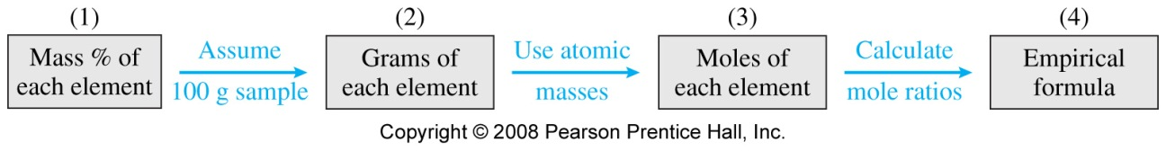
In Summary…

Slide 38
Determining the Formula of a Hydrocarbon by Combustion

Slide 39
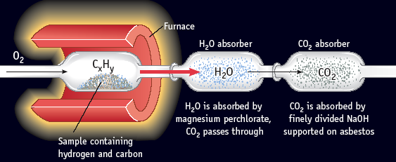
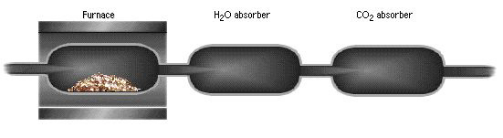
Determining the Formula of a Hydrocarbon by Combustion

Slide 40
Using Stoichiometry to Determine a Formula
Burn 0.115 g of a hydrocarbon, C_{x}H_{y}, and produce 0.379 g of CO₂ and
0.1035 g of H₂O.
C_{x}H_{y} + some oxygen → 0.379 g CO₂ + 0.1035 g H₂O
What is the empirical formula of C_{x}H_{y}?

Slide 41
C_{x}H_{y} + some oxygen → 0.379 g CO₂ + 0.1035 g H₂O
First, recognize that all C in CO₂ and all H in H₂O is from C_{x}H_{y}.
0.379 g CO₂
+O₂
1 CO₂ molecule forms for each C atom in C_{x}H_{y}
Puddle of C_{x}H_{y}
0.115 g
+O₂
0.1035 g H₂O
1 H₂O molecule forms for each 2 H atoms in C_{x}H_{y}

Slide 42
C_{x}H_{y} + some oxygen → 0.379 g CO₂ + 0.1035 g H₂O
First, recognize that all C in CO₂ and all H in H₂O is from C_{x}H_{y}.
1. Calculate amount of C in CO₂
2. Calculate amount of H in H₂O

Slide 43
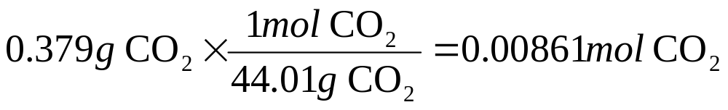
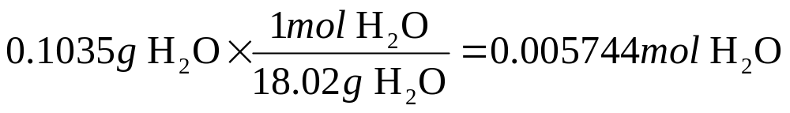
C_{x}H_{y} + some oxygen → 0.379 g CO₂ + 0.1035 g H₂O
Rule of thumb – If you get a mass, you will likely have to convert to moles

Slide 44
If we collect 0.00861 mol CO₂ in this combustion analysis, how many moles of Carbon were present in the initial sample?
1 mol
0.0258 mol
0.00861 mol
0.004305 mol
0
of
5
10

Slide 45
If we collect 0.00861 mol CO₂ in this combustion analysis, how many moles of Carbon were present in the initial sample?
1 mol
0.0258 mol
0.00861 mol
0.004305 mol
0
of
5
10

Slide 46
If we collect 0.005744 mol H₂O in this combustion analysis, how many moles of Hydrogen atoms were present in the initial sample?
1 mol
0.01149 mol
0.005744 mol
0.002872 mol
0
of
5
10

Slide 47
If we collect 0.005744 mol H₂O in this combustion analysis, how many moles of Hydrogen atoms were present in the initial sample?
1 mol
0.01149 mol
0.005744 mol
0.002872 mol
0
of
5
10

Slide 48
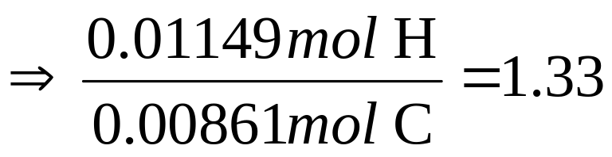
C_{x}H_{y} + some oxygen → 0.379 g CO₂ + 0.1035 g H₂O
Now find ratio of mol H/mol C to find values of x and y in C_{x}H_{y}.
x =
y =
But we cannot have CH_{1.33}
0.00861 mol
0.01149 mol
So…

Slide 49
C_{x}H_{y} + some oxygen → 0.379 g CO₂ + 0.1035 g H₂O
Now find ratio of mol H/mol C to find values of x and y in C_{x}H_{y}.
x =
y =
Empirical formula =
0.00861 mol
0.01149 mol
(CH_{1.33}) x 3 = C₃H₄
(propyne)

Slide 50
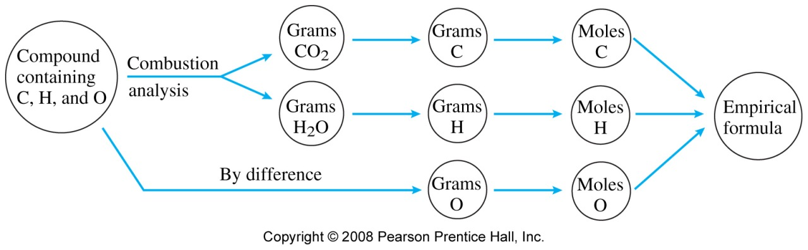
Another Case:
Combustion of a sample of a compound containing only carbon, hydrogen, and oxygen
C_{x}H _{y}O_{z}+ O₂→ CO₂ + H₂O

Slide 51
Example 3.20
C_{x}H _{y}O_{z}+ O₂→ CO₂ + H₂O
Combustion of a 0.8233 g sample of a compound containing only carbon, hydrogen, and oxygen produced the following:
CO₂ = 2.445 g
H₂O = 0.6003 g
  Determine the empirical formula of the compound

Slide 52
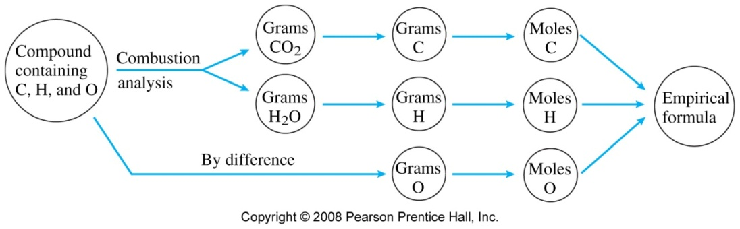
Example 3.20:
Find the empirical formula of compound with the given amounts of combustion products
Write down the given quantity and its units.
Given: compound = 0.8233 g
CO₂ = 2.445 g
H₂O = 0.6003 g

Slide 53
Example 3.20:
Find the empirical formula of compound with the given amounts of combustion products
Information
Given: 0.8233 g compound,
2.445 g CO₂, 0.6003 g H
Write down the quantity to find and/or its units.
  Find: empirical formula, C_{x}H_{y}O_{z}

Slide 54

Example 3.20:
Find the empirical formula of compound with the given amounts of combustion products
Information
Given: 0.8233 g compound,
2.445 g CO₂, 0.6003 g H
Find: Empirical Formula, C_{x}H_{y}O_{z}
Write a Concept Plan:
g
CO₂, H₂O
mol
CO₂, H₂O
mol
C, H
g
C, H
g
O
mol
O
mol
C, H, O
mol
ratio
empirical
formula
Tro, Chemistry: A Molecular Approach

Slide 55

Example 3.20:
Find the empirical formula of compound with the given amounts of combustion products
Information
Given: 0.8233 g compound,
2.445 g CO₂, 0.6003 g H₂O
Find: Empirical Formula, C_{x}H_{y}O_{z}
CP: g CO₂ & H₂O → mol CO₂ & H₂O → mol C & H → g C & H → g O → mol O →
mol ratio → empirical formula
Collect Needed Relationships:
1 mole CO₂ = 44.01 g CO₂
1 mole H₂O = 18.02 g H₂O
1 mole C = 12.01 g C
1 mole H = 1.008 g H
1 mole O = 16.00 g O
1 mole CO₂ = 1 mole C
1 mole H₂O = 2 mole H

Slide 56
Example 3.20:
Find the empirical formula of compound with the given amounts of combustion products
Information
Given: 0.8233 g compound
2.445 g CO₂, 0.6003 g H₂O
Find: Empirical Formula, C_{x}H_{y}O_{z}
CP: g CO₂ & H₂O → mol CO₂ & H₂O → mol C & H → g C & H → g O → mol O →
mol ratio → empirical formula
Rel: MM of CO₂, H₂O, C, H, O;
mol element : 1 mol compound
Apply the Concept Plan:
  calculate the moles of C and H
Tro, Chemistry: A Molecular Approach

Slide 57
Example 3.20:
Find the empirical formula of compound with the given amounts of combustion products
Information
Given: 0.8233 g compound, 2.445 g CO₂, 0.6003 g H₂O,
0.05556 mol C, 0.06662 mol H
Find: Empirical Formula, C_{x}H_{y}O_{z}
CP: g CO₂ & H₂O → mol CO₂ & H₂O → mol C & H →
g C & H → g O → mol O → mol ratio → emp. formula
Rel: MM of CO₂, H₂O, C, H, O;
mol element : 1 mol compound
Apply the Concept Plan:
  calculate the grams of C and H
Tro, Chemistry: A Molecular Approach

Slide 58
Example 3.20:
Find the empirical formula of compound with the given amounts of combustion products
Information
Given: 0.8233 g compound, 2.445 g CO₂, 0.6003 g H₂O, 0.05556 mol C, 0.6673 g C, 0.06662 mol H, 0.06715 g H, Find: Empirical Formula, C_{x}H_{y}O_{z}
CP: g CO₂ & H₂O → mol CO₂ & H₂O → mol C & H →
g C & H → g O → mol O → mol ratio → emp. formula
Rel: MM of CO₂, H₂O, C, H, O;
mol element : 1 mol compound
Apply the Concept Plan:
  calculate the grams and moles of O

Slide 59
Example 3.20:
Find the empirical formula of compound with the given amounts of combustion products
Information
Given: 0.8233 g compound, 2.445 g CO₂, 0.6003 g H₂O, 0.05556 mol C, 0.6673 g C, 0.06662 mol H, 0.06715 g H, 0.0889 g O, 0.00556 mol O
Find: Empirical Formula, C_{x}H_{y}O_{z}
CP: g CO₂ & H₂O → mol CO₂ & H₂O → mol C & H →
g C & H → g O → mol O → mol ratio → emp. formula
Rel: MM of CO₂, H₂O, C, H, O;
mol element : 1 mol compound
Apply the Concept Plan:
  write a pseudoformula
C_{0.05556}H_{0.06662}O_{0.00556}
Tro, Chemistry: A Molecular Approach

Slide 60
Example 3.20:
Find the empirical formula of compound with the given amounts of combustion products
Information
Given: 0.8233 g compound, 2.445 g CO₂, 0.6003 g H₂O, 0.05556 mol C, 0.6673 g C, 0.06662 mol H, 0.06715 g H, 0.0889 g O, 0.00556 mol O
Find: Empirical Formula, C_{x}H_{y}O_{z}
CP: g CO₂ & H₂O → mol CO₂ & H₂O → mol C & H →
g C & H → g O → mol O → mol ratio → emp. formula
Rel: MM of CO₂, H₂O, C, H, O;
mol element : 1 mol compound
Apply the Concept Plan:
  find the mole ratio by dividing by the smallest number of moles

Slide 61
Example 3.20:
Find the empirical formula of compound with the given amounts of combustion products
Information
Given: 0.8233 g compound, 2.445 g CO₂, 0.6003 g H₂O, 0.05556 mol C, 0.6673 g C, 0.06662 mol H, 0.06715 g H, 0.0889 g O, 0.00556 mol O
Find: Empirical Formula, C_{x}H_{y}O_{z}
CP: g CO₂ & H₂O → mol CO₂ & H₂O → mol C & H →
g C & H → g O → mol O → mol ratio → emp. formula
Rel: MM of CO₂, H₂O, C, H, O;
mol element : 1 mol compound
Apply the Concept Plan:
  multiply subscripts by factor to give whole number, if necessary
  write the empirical formula

